Slide 1
Nest JS

Slide 2
Nest is a framework for building efficient, scalable node.js server-side applications
Bit confusing what is Nest and why we are going for it?
I would have mentioned the prerequisites
Before going to this framework, we will touch upon the basics.

Slide 3
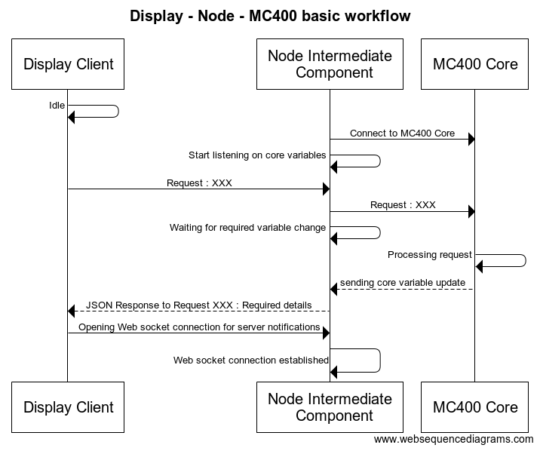

Slide 4
Javascript, What Are You?
A single threaded non-blocking asynchronous concurrent language. It has a call stack, an event loop, a call-back queue and some other api’s
It seems the words are contradicting “single” and “concurrent”
one thread == one stack == one thing at a time

Slide 5
Sample Program:
console.log('Hello');
setTimeout(function timeout() {
console.log("timeout function");
}, 5000);
console.log('world');

Slide 6
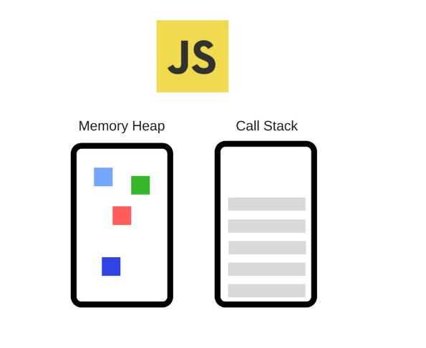
V8 Runtime
Where is the event loop, queue, asynchronous methods like settimeout, ajax, DOM lets see in next slide

Slide 7
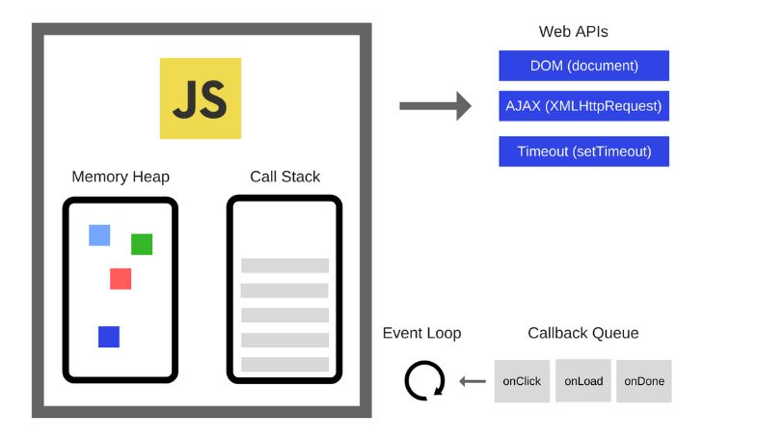
JS engine
Shall we visualize this runtime with some examples on how asynchronous, concurrency achieved using single stack
Try it out!!!

Slide 8
Why Node js? Why can’t javascript itself shouldn’t do this?
Node.js is a JavaScript runtime built on Chrome's V8 JavaScript engine. Node.js uses an event-driven, non-blocking I/O model that makes it lightweight and efficient. Node.js package ecosystem, npm, is the largest ecosystem of open source libraries in the world

Slide 9
Node engine
C++ API’s
asynchronous I/O
Http
fs
Timeout(setTimeout)

Slide 10
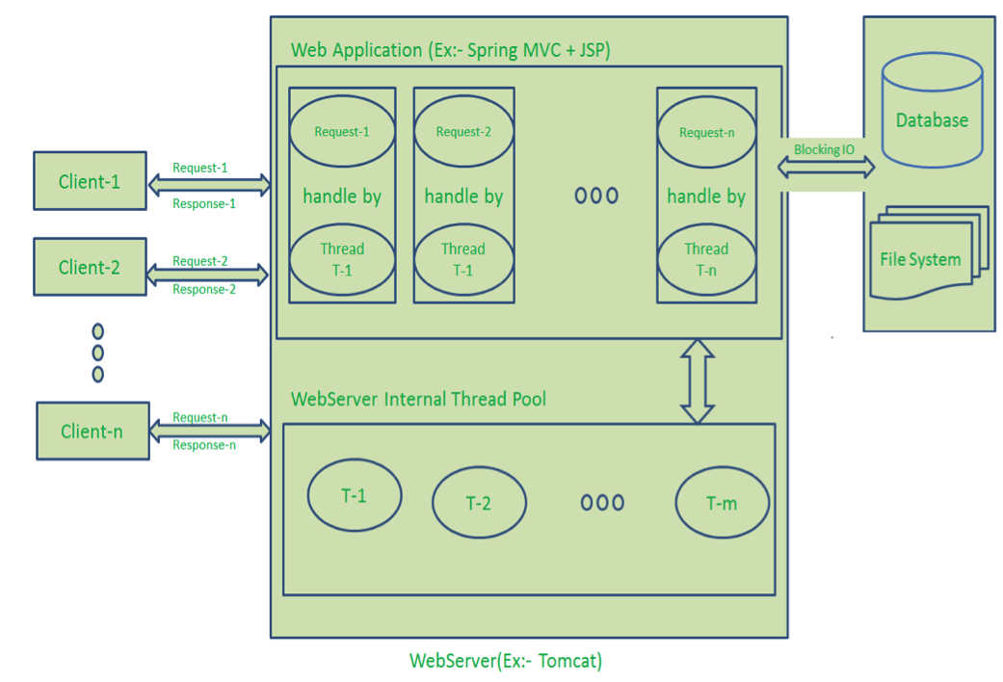
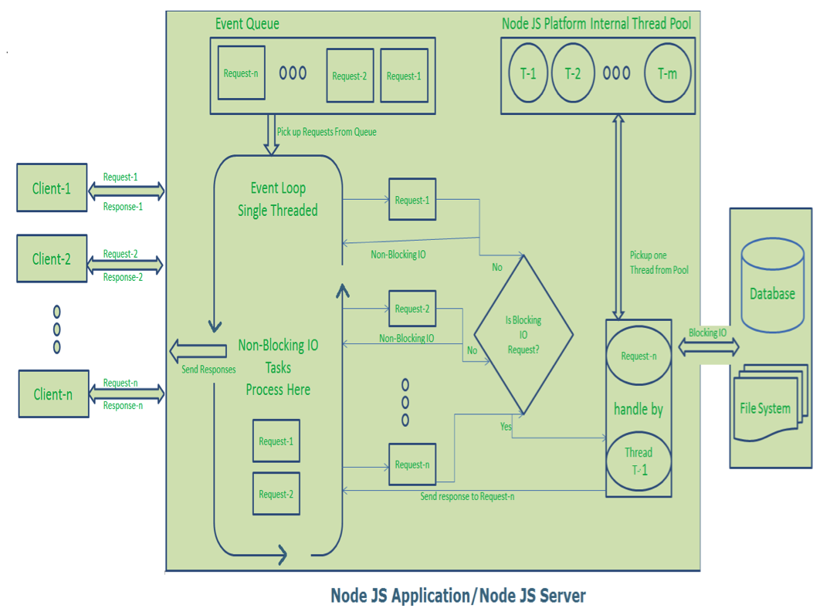
Existing Request/Response Architecture
Node js Request/Response Architecture (Single Threaded)

Slide 11
Node js sample program
console.log('Hello');
setTimeout(function timeout() {
console.log("timeout function");
}, 5000);
console.log('world');
var http = require('http’);
http.createServer(function (req,res) {
res.write(‘Hello World! ‘);
res.end();
}).listen(8080);

Slide 12
Nest is a framework for building efficient, scalable Node.js server-side applications. It provides an application architecture out of the box which allows for effortless creation of highly testable, scalable, loosely coupled and easily maintainable applications.
Hopefully now we can get into Nest js framework

Slide 13
Websockets
Express server
Swagger
Nest JS
Dependency Injection
Test mock providers
Pipes, Guards
Middlewares,
ExceptionFilter

Slide 14
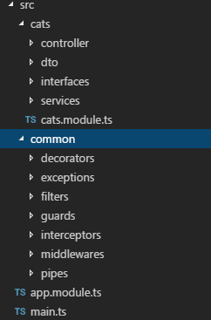
Key Concepts Folder Structure
Controllers - handling incoming requests and returning a response to the client
Components - Service, Repository, Factory, Helper [...] and they can be injected into controllers or into other components through constructor
Modules – It is a core component to organize the application structure. Each features are separated and related components within features are grouped together Ex. Ecash Module, Pre-commitment Module
Try it out!!!!

